Slide 1

Software Solution for Sporting Event Systems
This presentation outlines a comprehensive software solution for managing sporting events, leveraging Spring Boot, Angular, and MySQL.
-Presented by: Rajat Lad

Slide 2
Overview of the Application
Streamlined Management
Enhanced User Experience
Centralized platform for managing all aspects of sporting events
Intuitive interface for administrators and fans alike

Slide 3

Backend: Spring Boot
Robust Framework
Data Persistence
Provides a powerful foundation for building scalable and reliable backend services
Manages data storage and retrieval, ensuring data integrity
API Integration
Facilitates communication between the frontend and backend

Slide 4



Frontend: Angular
Modern UI
Performance Optimization
Provides a visually appealing and interactive user interface
Ensures fast and smooth performance for users

Slide 5
Database: MySQL
Data Integrity
Scalability
Security
Ensures consistent and accurate data storage
Supports the growth of data as the platform expands
Protects sensitive data from unauthorized access

Slide 6
Modules: Teams, Players, Tournaments, Matches, Tickets
Team Management
1
2
Player Management
Tournament Management
3
4
Match Management
Ticket Management
5

Slide 7
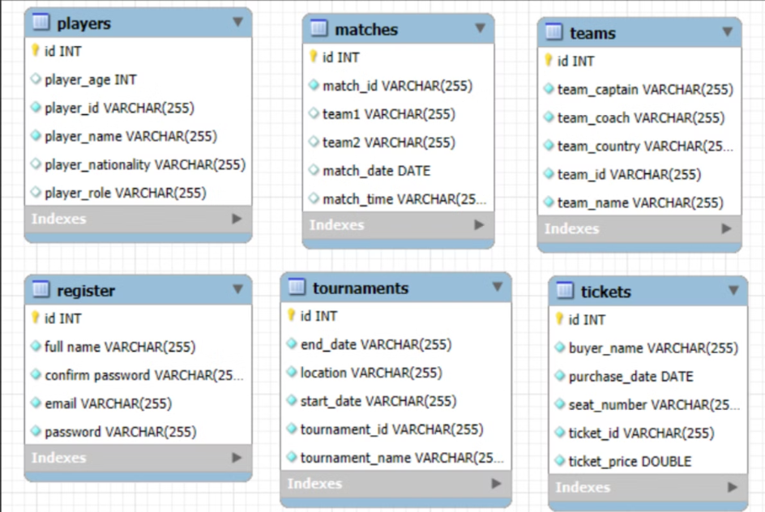
Database Implementation:
Database ER Diagram
The database ER diagram provides a visual representation of the relationships between the different tables and entities in the database. It helps to understand the structure and dependencies of the data model.

Slide 8
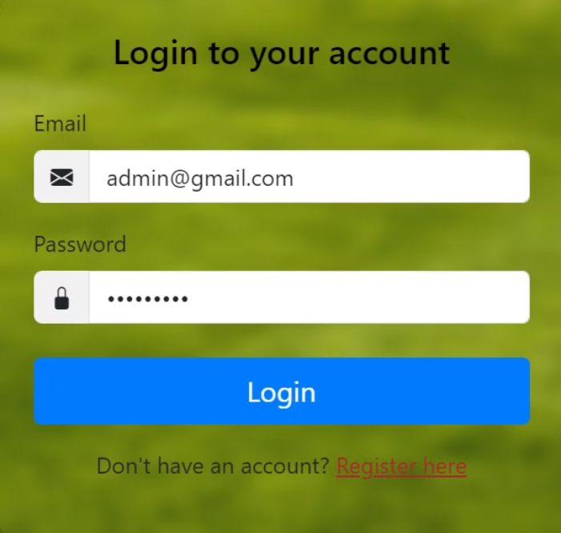
Frontend Implementation:
Login Component
Admin can login here to access the dashboard. Added with necessary validators.

Slide 9
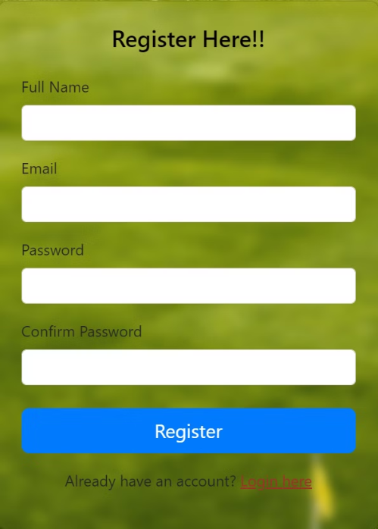
Register Component
For new Admin registration. User can register here and then proceed with login and access dashboard. Added with necessary validators.

Slide 10
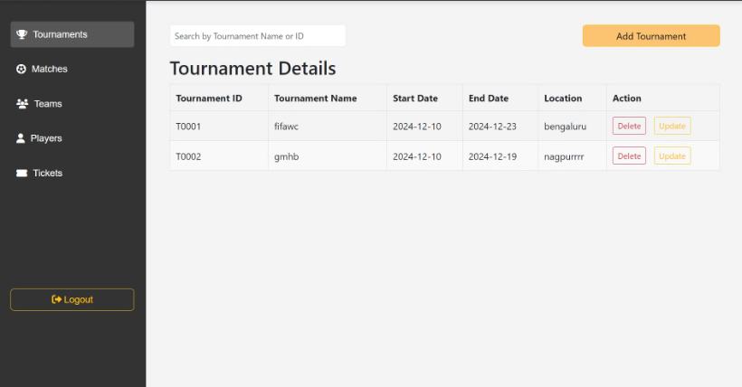
Dashboard Component
This component displays the main dashboard interface for the logged-in admin. It includes various widgets and charts to provide an overview of important metrics and data.
Admin can perform CRUD operations as required.

Slide 11
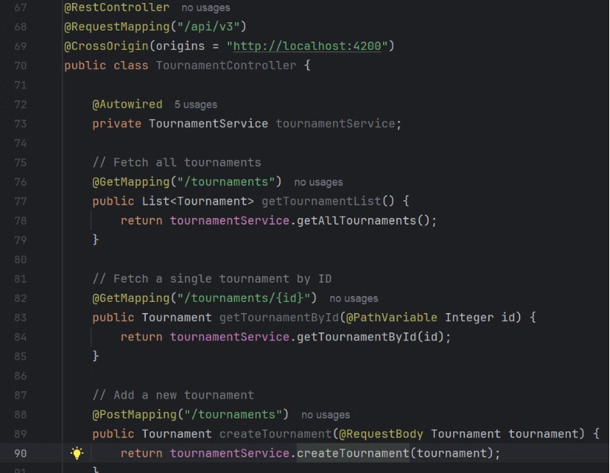
Backend Implementation
Controller:
The backend implementation includes a controller that serves as an intermediary between the frontend interface and the entity. The controller is responsible for receiving requests from the frontend, accessing the entity's methods, and returning the appropriate responses.

Slide 12
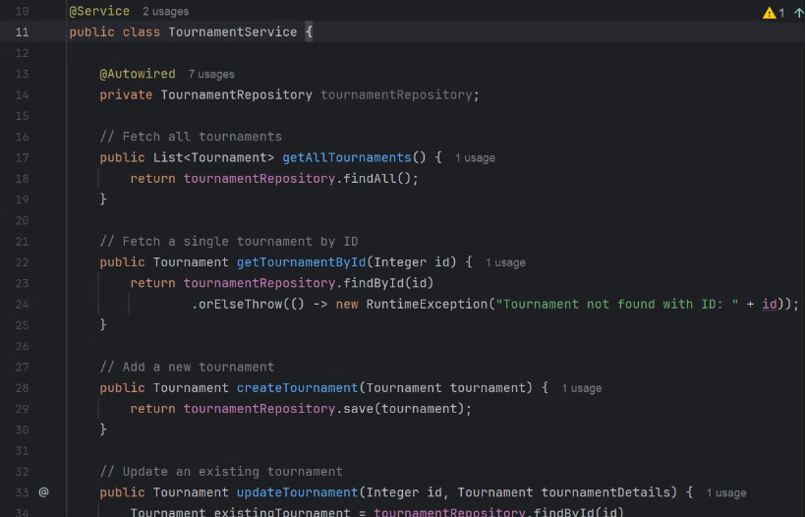
Service:
The service layer acts as an intermediary between the frontend and the backend. It receives requests from the frontend and delegates them to the appropriate entity methods. Additionally, the service layer can apply any necessary business logic before executing the requested operations. This helps keep the code organized and maintainable.

Slide 13
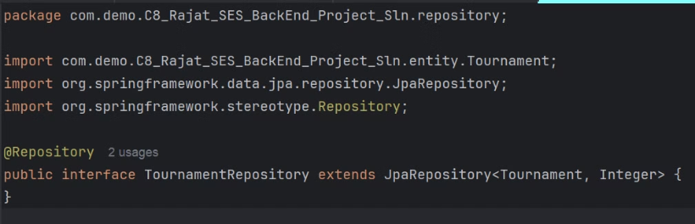
Repository:
The repository layer is responsible for interacting with the database or any other data storage system. It provides methods for querying, inserting, updating, and deleting data.

Slide 14
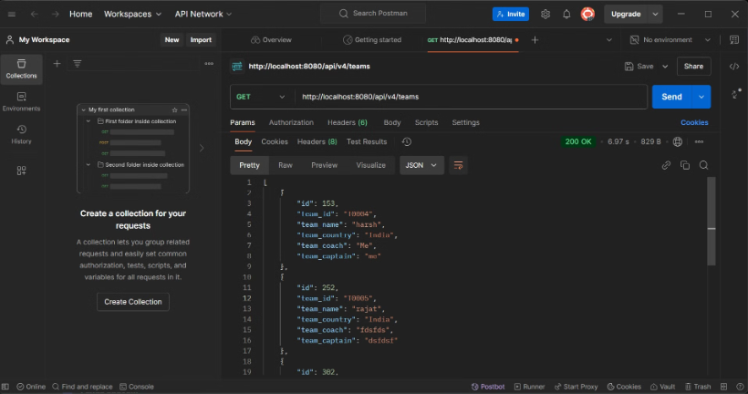
Testing using Postman
API Testing:
API testing is an essential part of the software development lifecycle as it ensures that the API endpoints are functioning correctly and delivering the expected results.

Slide 15
Thank You :)

